Slide 1
Amazon Music Clustering
Using Unsupervised Machine Learning
Jayaseeli S
DS-C-WD-E-B96

Slide 2
Problem Statement :
With millions of songs available on platforms like Amazon, manually categorizing tracks into genres is impractical.
The goal of this project is to automatically group similar songs based on their audio characteristics using clustering techniques.
By analyzing patterns in features such as tempo, energy, danceability, and more, learners will develop a model that organizes songs into meaningful clusters, potentially representing different musical genres or moods—without any prior labels.

Slide 3
Objectives
Explore and preprocess Amazon Music dataset
Normalize audio features
Apply K-Means clustering
Identify optimal number of clusters
Visualize and interpret song clusters

Slide 4
Dataset Information
95,837 songs
23 original features
Removed text columns
id_songs
, name_song
, id_artists,
release_date,
genres,
name_artists
Selected 10 sound-related features
Danceability,
energy,
loudness,
speechiness,
acousticness,
Instrumentalness
liveness,
valence,
tempo,
duration_ms
id_songs
name_song
popularity_songs
explicit
duration_ms
id_artists
release_date
danceability
energy
key
loudness
mode
speechiness
acousticness
instrumentalness
liveness
valence
tempo
time_signature
followers
genres
name_artists
popularity_artists

Slide 5
EDA
Removed duplicates
Dropped irrelevant text columns
Used StandardScaler for normalization
Scaling prevents dominance of loudness & tempo

Slide 6
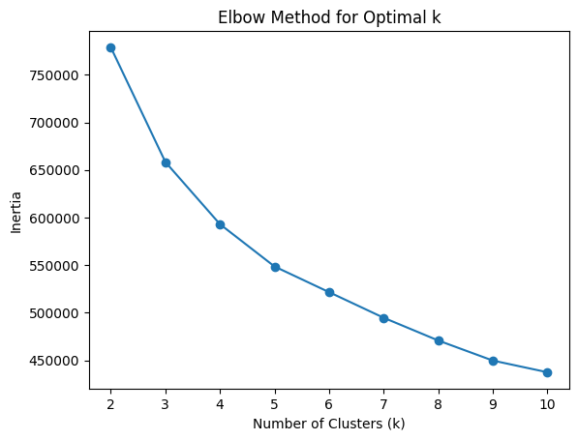
Finding Optimal Clusters
Elbow Method suggests k = 4
Silhouette Score comparison
Best silhouette ≈ 0.231
Final model: KMeans (k=4)

Slide 7
Evaluation Metrics
Silhouette Score: 0.231
Davies-Bouldin Index: 1.53
Inertia for compactness

Slide 8
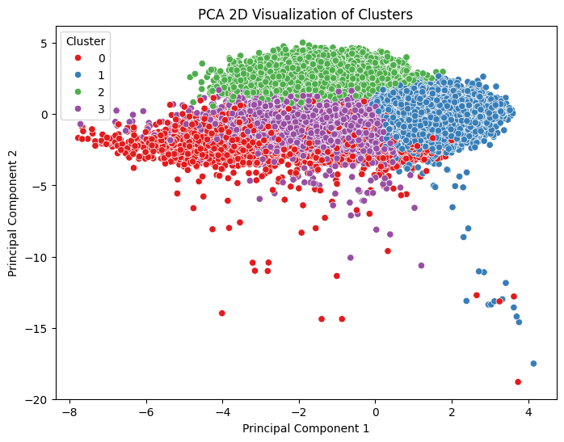
Dimensionality Reduction
PCA for 2D visualization
Principal Component
Analysis
Helps reduce dimensions
while preserving variance.

Slide 9
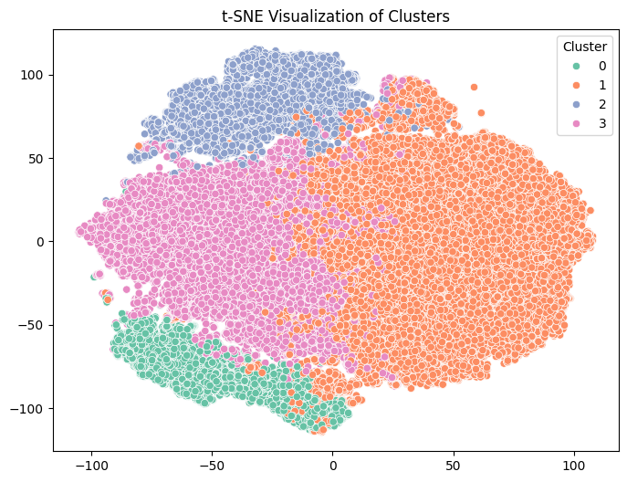
t-SNE
For complex structure visualization
Clear separation
between clusters observed

Slide 10
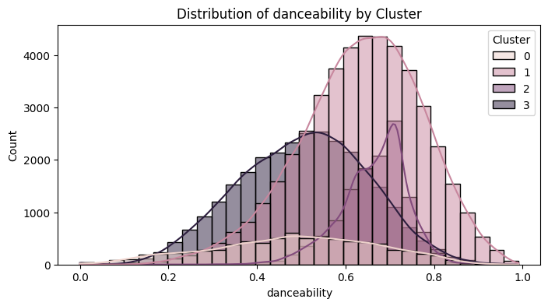
Danceability
What the Image Shows:
Most songs are concentrated in the medium to high danceability range (0.5–0.8).
Few tracks exist in very low danceability (< 0.3).
Interpretation:
The dataset is dominated by rhythm-friendly and groove-based songs.
Highly danceable tracks are likely pop, commercial, or upbeat genres.
Lower danceability songs may represent classical, ambient, or slow emotional tracks.

Slide 11
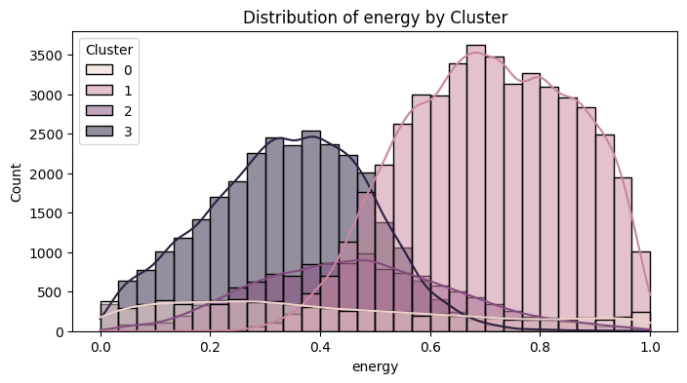
ENERGY
What the Image Shows
Large concentration in the medium to high energy (0.6–0.9) range.
Fewer low-energy songs.
Interpretation:
The dataset mainly contains energetic tracks.
High energy songs are likely party, EDM, rock, or commercial pop.
Low energy songs may represent instrumental or acoustic music.

Slide 12
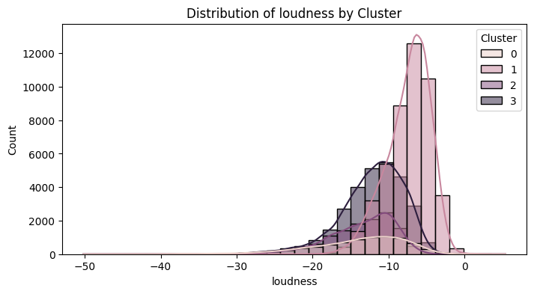
lOUDNESS
What the Image Shows:
Most songs cluster around -5 dB to -10 dB.
Very few extremely quiet tracks.
Interpretation:
Modern music production trend: louder mastering.
Tracks are professionally mixed and commercially produced.
Loud songs usually correlate with high energy.

Slide 13
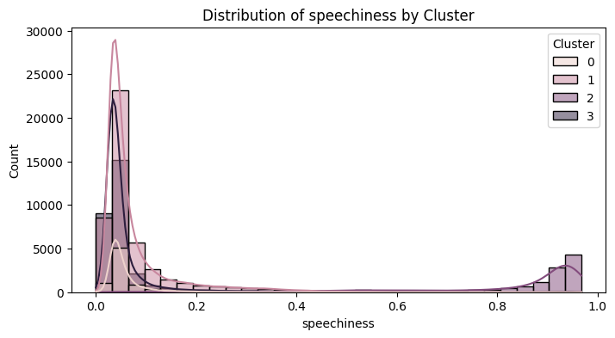
SPEECHINESS
What the Image Shows:
Majority of songs have low speechiness (< 0.3).
Small peak near very high values (around 0.9–1.0).
Interpretation:
Most songs are melodic with singing rather than spoken word.
The small high-speechiness spike likely represents:
  Rap / Hip-hop
  Spoken word
  Dialogue-heavy tracks
This feature clearly separates rap-based clusters.

Slide 14
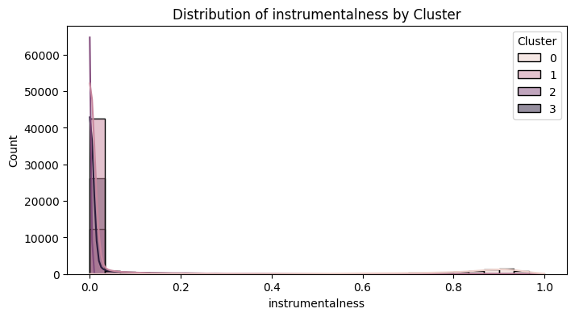
INSTRUMENTALNESS
What the Image Shows:
Most tracks have very low instrumentalness (near 0).
Small group has very high instrumentalness (> 0.8).
Interpretation:
Majority of dataset contains vocals.
High instrumentalness tracks likely represent:
  Classical
  Background scores
  Lo-fi / ambient
This feature helps isolate instrumental cluster.

Slide 15
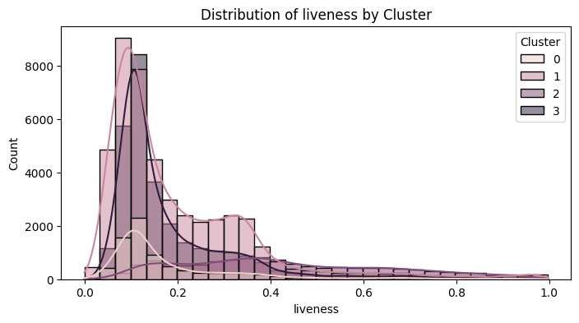
LIVENESS
What the Image Shows:
Most songs have low to moderate liveness.
Few songs show high liveness (> 0.7).
Interpretation:
Majority are studio recordings.
High liveness tracks likely represent:
  Live concerts
  Acoustic sessions
Recorded audience performances

Slide 16
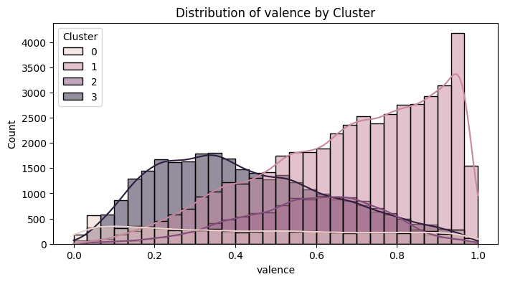
VALENCE
What the Image Shows:
Spread across full range.
Slight concentration in mid-range (0.4–0.7).
Interpretation:
Dataset contains both happy and sad songs.
High valence → cheerful, upbeat music.
Low valence → emotional, sad, darker tone.
This feature helps define emotional clusters.

Slide 17
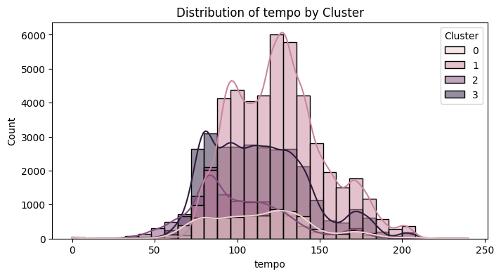
TEMPO
What the Image Shows:
Most songs fall between 90–140 BPM.
Few very slow (<70 BPM) or very fast (>170 BPM).
Interpretation:
Dataset reflects mainstream tempo range.
100–130 BPM = pop & dance music dominance.
Extreme tempos may represent special genres.

Slide 18
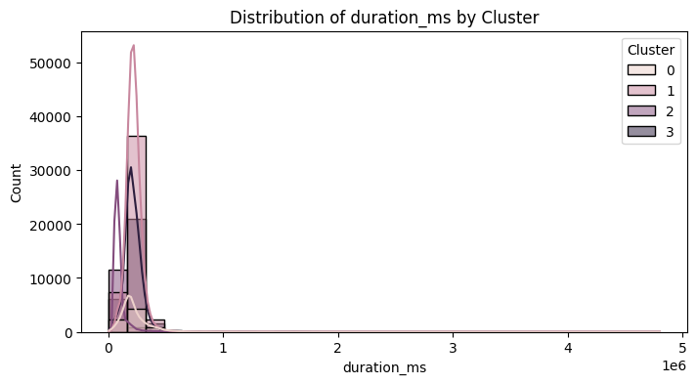
DURATION
What the Image Shows:
Most songs are between 180–300 seconds (3–5 minutes).
Few long-duration tracks.
Interpretation:
Typical commercial song length.
Longer tracks may represent:
  Instrumentals
  Classical
  Extended mixes

Slide 19
Overall Insight from All Images
Dataset is dominated by commercial, energetic, vocal-based songs.
A smaller segment represents:
  Instrumental tracks
  Rap/spoken tracks
  Emotional or low-energy songs
These distributions justify why clustering separated songs into:
Energetic Pop Cluster
Instrumental Cluster
Rap/Speech Cluster
Emotional/Alternative Cluster

Slide 20
Feature | Cluster 0 | Cluster 1 | Cluster 2 | Cluster 3
Energy | Low | Highest | Moderate | Lowest
Instrumentalness | Very High | Very Low | Near Zero | Very Low
Speechiness | Low | Low | Extremely High | Low
Acousticness | High | Low | Moderate | Highest
Valence | Neutral | Highest (Happy) | Moderate | Lowest
Duration | Normal | Normal | Shortest | Normal

Slide 21
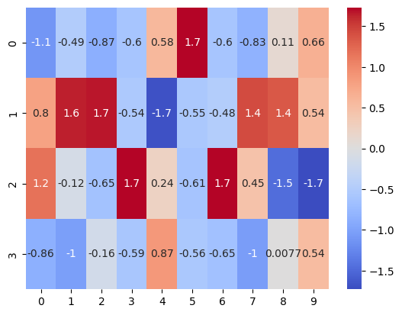
visualizes the average feature values of each cluster using a heatmap.
Instead of reading numbers in a table, we use colors to quickly compare patterns across clusters.
heatmap shows the average audio feature values per cluster. The coolwarm color scale helps visually identify high and low feature intensities, making it easier to interpret the characteristics of each cluster
  Blue = Low value
  Red = High value
  White/light color = Medium value
If Cluster 0 has red in energy and danceability → It’s energetic music.
If Cluster 2 has red in instrumentalness → It’s instrumental music.

Slide 22
Cluster 0 Instrumental / Acoustic Focus Music
Values:
Meaning:
Danceability: 0.49 (moderate)
Energy: 0.42 (medium)
Loudness: -14 (lower volume)
Acousticness: 0.65 (high)
Instrumentalness: 0.81 (very high)
Tempo: 110 BPM
Valence: 0.45 (neutral mood)
Very high instrumentalness
High acousticness
Moderate tempo
Low loudness

Slide 23
Cluster 1 Party / Dance Pop Music
Values
Meaning
Danceability: 0.63 (high)
Energy: 0.71 (high)
Loudness: -7.4 (loud)
Acousticness: 0.24 (low)
Instrumentalness: 0.021 (very low)
Valence: 0.69 (positive mood)
Tempo: 130 BPM
Energetic
Danceable
Vocal-based (low instrumentalness)
Positive feeling

Slide 24
Cluster 3 Chill Acoustic / Soft Pop
Values
Meaning
Danceability: 0.51
Energy: 0.34 (low)
Acousticness: 0.70 (very high)
Instrumentalness: 0.017 (low)
Valence: 0.43 (neutral)
Tempo: 110 BPM
Very acoustic
Calm energy
Vocal-based
Soft profile

Slide 25
Cluster | Defining Feature | Overall Mood | Likely Genre Type
0 | Very high instrumentalness | Calm / Atmospheric | Instrumental / Ambient
1 | High energy + high valence | Happy / Party | Pop / Dance
2 | Extremely high speechiness | Lyrical / Rap-focused | Hip-hop / Spoken
3 | Moderate everything, lower valence | Emotional / Indie | Alternative / R&B

Slide 26
Output
cluster_0.csv
cluster_1.csv
cluster_2.csv
Console Message:
"Cluster files exported successfully."

Slide 27
Conclusion
The clustering process successfully segmented the dataset into meaningful groups.
By exporting each cluster separately:
The dataset becomes easier to interpret
Enables deeper analysis
Supports business intelligence and reporting
Improves model deployment flexibility
This marks the final stage of the clustering workflow.

Slide 28
Business Use Cases
Personalized Playlist Curation: Automatically group songs that sound similar to enhance playlist generation.
Improved Song Discovery: Suggest similar tracks to users based on their preferred audio profile.
Artist Analysis: Help artists and producers identify competitive songs in the same audio cluster.
Market Segmentation: Streaming platforms can use clusters to analyze user listening patterns and optimize recommendations or promotions.

Slide 29
Thank you

